Slide 1
Introduzione a Azure nel 2024
Marco Parenzan

Slide 3
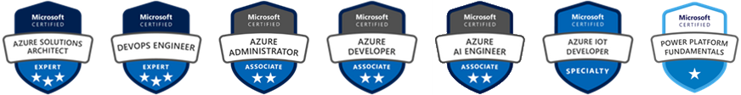


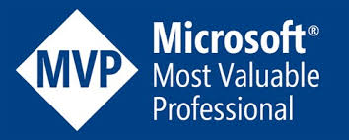


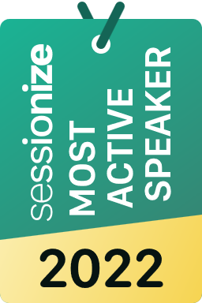

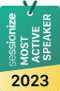
Who am I
marco_parenzan
marcoparenzan
marcoparenzan
MARCO PARENZAN
marcoparenzan

Slide 4
Introduzione a Azure nel 2024
Marco Parenzan

Slide 5
DOMANDE?

Slide 6
In 2010...
In an era of web, providers
A new hosting...
VMs and Cloud Services
Windows Azure
Utility Computing

Slide 7
Why Azure?
Cost Optimization
Manage a continuous improoving business
App innovation

Slide 8
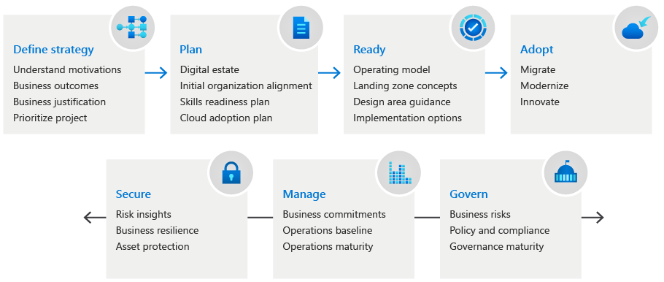
What is Cloud Adoption Framework
Cloud Adoption Framework (CAF) è una guida completa che copre l'intero percorso verso il cloud, dalla strategia alla governance. Fornisce procedure consigliate, strumenti e linee guida per ogni fase del ciclo di vita dell'adozione del cloud: definire la strategia, pianificare, preparare, adottare, governare e gestire. Il CAF ti aiuta ad allineare i tuoi obiettivi aziendali con la tua visione cloud, valutare la tua preparazione, preparare il tuo ambiente, implementare le tue soluzioni e ottimizzare le tue operazioni.
https://learn.microsoft.com/en-us/azure/cloud-adoption-framework/

Slide 9
Why are we moving to the cloud
Critical business events | Migration | Innovation
Datacenter exit | Cost savings | Preparation for new technical capabilities
Merger, acquisition, or divestiture | Reduction in vendor or technical complexity | Building new technical capabilities
Reduction in capital expenses | Optimization of internal operations | Scaling to meet market demands
End of support for mission-critical technologies | Increase in business agility | Scaling to meet geographic demands
Response to regulatory compliance changes | Preparation for new technical capabilities | Improved customer experiences and engagements
New data sovereignty requirements | Scaling to meet market demands | Transformation of products or services
Reduction of disruptions and improvement of IT stability | Scaling to meet geographic demands | Market disruption with new products or services
Report and manage the environmental impact of your business | Integration of a complex IT portfolio | Democratization and/or self-service environments

Slide 10
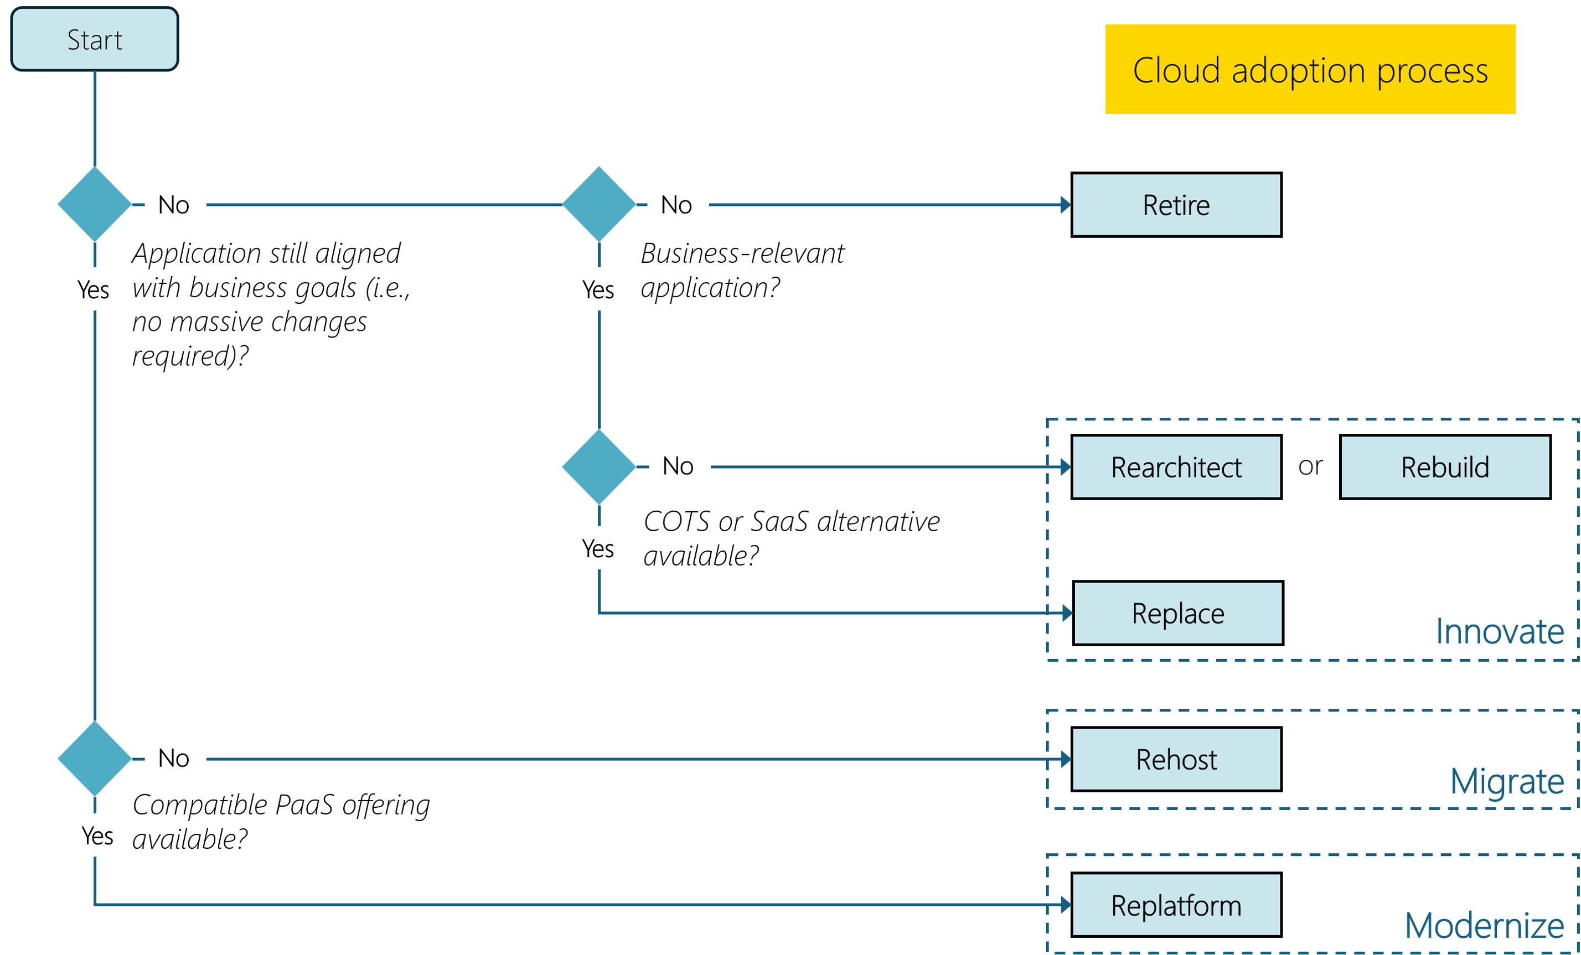
Adopt Azure (for CAF)

Slide 11
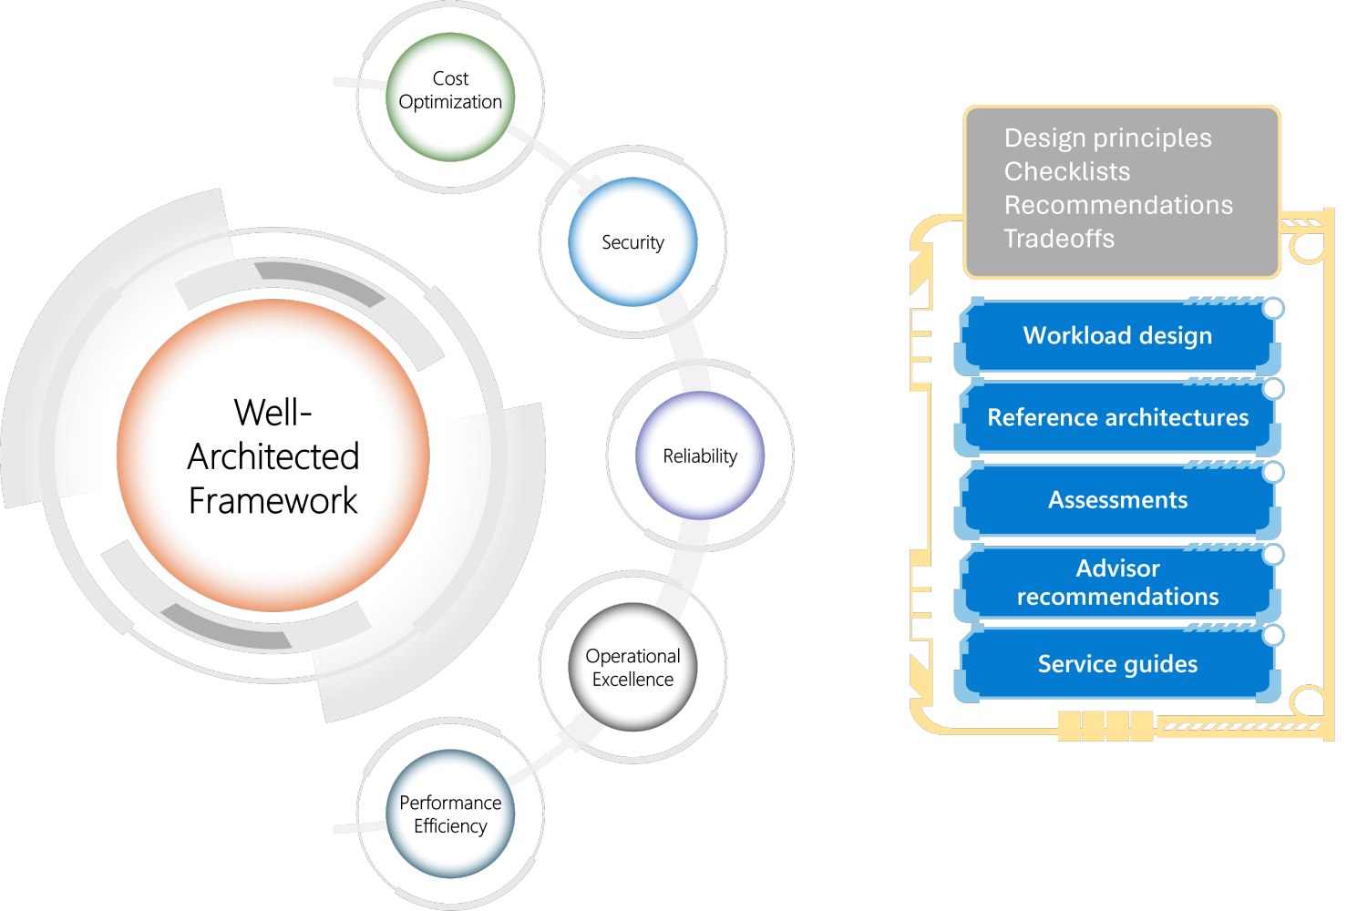
What is Well-Architected Framework
Il Well-Architected Framework (WAF) è un insieme di principi e linee guida che consentono di progettare e gestire sistemi affidabili, sicuri, efficienti e convenienti nel cloud. Si compone di cinque pilastri: eccellenza operativa, sicurezza, affidabilità, efficienza delle prestazioni e ottimizzazione dei costi. Il WAF consente di valutare l'architettura in base a questi pilastri e di identificare le aree di miglioramento. Fornisce inoltre le migliori pratiche e raccomandazioni per ciascun pilastro.
https://learn.microsoft.com/en-us/azure/well-architected/

Slide 12
Well Architected Framework
Pillar | Workload concern | Apply the principles
Reliability | Resiliency, availability, recovery | Design for business requirements, resilience, recovery, and operations, while keeping it simple.
Security | Data protection, threat detection, and mitigation | Protect confidentiality, integrity, and availability.
Cost Optimization | Cost modeling, budgets, reduce waste | Optimize on usage and rate utilization while keeping a cost-efficient mindset.
Operational Excellence | Holistic observability, DevOps practices | Streamline operations with standards, comprehensive monitoring, and safe deployment practices.
Performance Efficiency | Scalability, load testing | Scale horizontally, test early and often, and monitor the health of the solution.

Slide 13
How are they different
Entrambi i framework sono rilevanti quando si tratta di una migrazione al cloud, ma hanno ambiti e scopi diversi. Il CAF si concentra sugli aspetti aziendali e organizzativi dell'adozione del cloud, mentre il WAF si concentra sugli aspetti tecnici e operativi dell'architettura cloud. Il CAF consente di pianificare ed eseguire la migrazione al cloud, mentre il WAF consente di esaminare e ottimizzare l'architettura cloud.

Slide 14
How are they related
Uno dei concetti chiave del CAF è la Azure Landing Zone Architecture di Azure, ovvero un set di principi di progettazione e procedure consigliate per la creazione di una base scalabile e sicura per l'ambiente cloud. Consente di stabilire componenti di base come identità, rete, sicurezza, governance, operazioni e struttura di sottoscrizione. Ti aiuta anche a integrare i tuoi sistemi e processi esistenti con il cloud. Uno degli strumenti chiave del WAF è Azure Well-Architected Review (WAR), un'autovalutazione che consente di misurare l'allineamento con i cinque pilastri e identificare le lacune e i rischi. Fornisce inoltre consigli e risorse utili per migliorare l'architettura. È possibile usare il punteggio di Azure Advisor per tenere traccia dello stato di avanzamento e assegnare priorità alle azioni in base all'impatto e all'impegno.

Slide 15
Introduction to Cloud

Slide 16
Cloud Benefits
High availability
Fault tolerance
Scalability
Elasticity
Global reach
Customer latency capabilities
Agility
Predictive cost considerations
Disaster recovery
Security
Notes:
There is a term reference guide available at https://azure.microsoft.com/en-us/overview/cloud-computing-dictionary/
Learn and SkillPipe content order note:
Slides 11-15 https://docs.microsoft.com/en-us/learn/modules/fundamental-azure-concepts/benefits-of-cloud-computing

Slide 17
Compare CapEx vs. OpEx
Capital Expenditure (CapEx)
The up-front spending of money on physical infrastructure.
Costs from CapEx have a value that reduces over time.
Operational Expenditure (OpEx)
Spend on products and services as needed, pay-as-you-go
Get billed immediately
Notes:
Capital Expenditure (CapEx)
Spend on physical infrastructure upfront.
Deduct the expense from your tax bill.
High upfront cost, but the value of your 6investment reduces over time.
Operational Expenditure (OpEx)
Spend on services or products as needed.
Get billed immediately.
Deduct the expense from your tax bill in the same year.
No upfront cost, pay-as-you use.
Learn and SkillPipe content order note:
Slides 11-15 https://docs.microsoft.com/en-us/learn/modules/fundamental-azure-concepts/benefits-of-cloud-computing

Slide 18
Consumption-based model
Cloud service providers operate on a consumption-based model, which means that end users only pay for the resources that they use. Whatever they use is what they pay for.
Better cost prediction
Prices for individual resources and services are provided
Billing is based on actual usage
Notes:
This consumption-based model brings with it many benefits, including:
No upfront costs.
No need to purchase and manage costly infrastructure that they may or may not use to its fullest.
The ability to pay for additional resources when they are needed.
The ability to stop paying for resources that are no longer needed.
Learn/SkillPipe content note:
Slides 11-15 https://docs.microsoft.com/en-us/learn/modules/fundamental-azure-concepts/benefits-of-cloud-computing

Slide 19
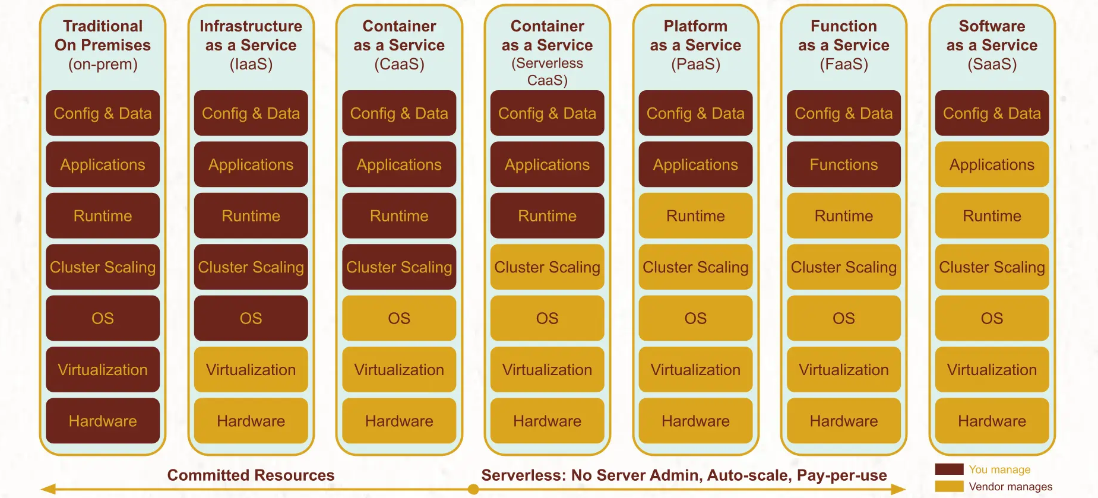
Shared responsibility model

Slide 20
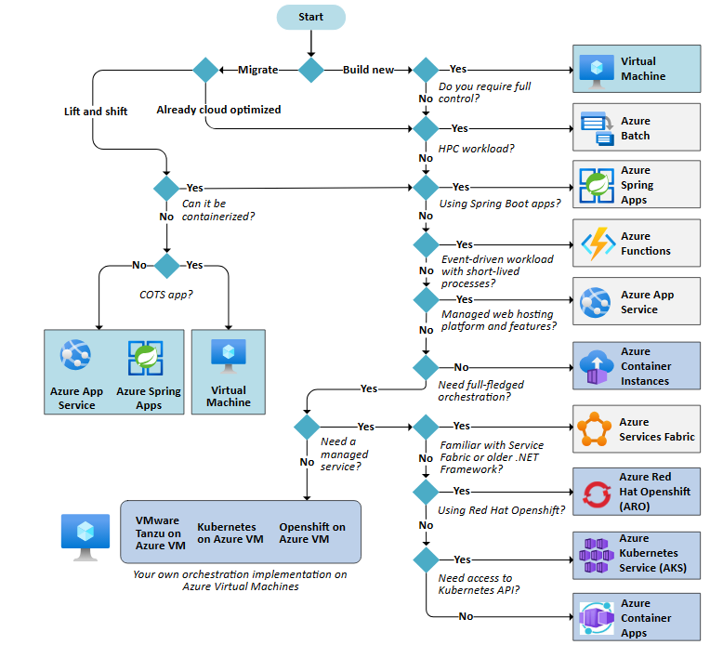
Choose an Azure compute service

Slide 21
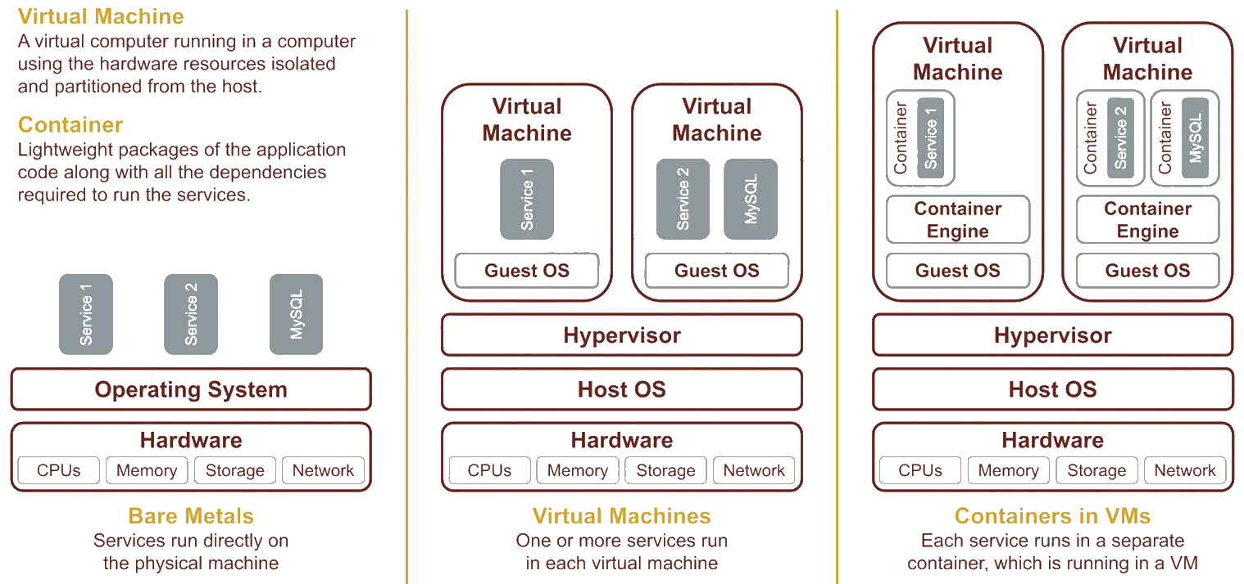
Virtual Machines vs. Containers
Notes:
https://www.ml4devs.com/articles/serverless-architecture-for-microservices-on-aws-vs-google-cloud-vs-azure-as-iaas-caas-paas-faas/

Slide 22
Choose an Azure container service
Azure Container Apps is a fully managed Kubernetes-based application platform that helps you deploy HTTP and non-HTTP apps from code or containers without orchestrating infrastructure. For more information, see Azure Container Apps documentation.
Azure Kubernetes Service (AKS) is a managed Kubernetes service for running containerized applications. With AKS, you can take advantage of managed add-ons and extensions for additional capabilities while preserving the broadest level of configurability. For more information, see AKS documentation.
Web App for Containers is a feature of Azure App Service, a fully managed service for hosting HTTP-based web apps with built-in infrastructure maintenance, security patching, scaling, and diagnostic tooling. For more information, see App Service documentation.

Slide 23
File and object storage scenarios
Scenario | Suggested Azure services
I use Windows file server. | Azure Files or Azure File Sync
I have an enterprise network attached storage such as NetApp or Dell-EMC Isilon. | Azure NetApp Files or Azure Files (premium)
I have an SMB or NFS file share. | Azure Files or Azure NetApp Files
I have an on-premises object storage system for petabytes of data, such as Dell-EMC ECS. | Blob Storage
I have a Distributed File System Replication deployment or another way of handling branch offices. | Azure Files or Azure File Sync
I have a tape library for backup and disaster recovery or long-term data retention. | Blob Storage
I have file or object storage configured to receive my backups. | Blob Storage or Azure File Sync
I run data replication to a disaster recovery site. | Azure Files, Azure NetApp Files or Azure File Sync
I manage data transfer in disconnected scenarios. | Azure Stack Edge or Data Box Gateway
I manage an ongoing data pipeline to the cloud. | Azure Stack Edge or Data Box Gateway
I have bursts of data that arrive at the same time. | Azure Stack Edge or Data Box Gateway

Slide 24
Plan based on data workloads
Scenario | Suggested Azure services
I want to develop a new cloud-native application that needs to persist unstructured data. | Blob Storage
I need to migrate data from an on-premises NetApp instance to Azure. | Azure NetApp Files
I need to migrate data from on-premises Windows file server instances to Azure. | Azure Files
I need to move file data to the cloud but continue to primarily access the data from on-premises. | Azure Files or Azure File Sync
I need to support burst compute. I have NFS/SMB read-heavy, file-based workloads with data assets that are on-premises while computation runs in the cloud. | Avere vFXT for Azure
I need to move an on-premises application that uses a local disk or iSCSI. | Azure disk storage
I need to migrate a container-based application that has persistent volumes. | Azure disk storage or Azure Files
I need to move file shares that aren't on Windows Server or NetApp to the cloud. | Azure Files or Azure NetApp Files
I need to transfer terabytes to petabytes of data from on-premises to Azure. | Azure Stack Edge
I need to process data before transferring it to Azure. | Azure Stack Edge
I need to support continuous data ingestion in an automated way by using local cache. | Data Box Gateway

Slide 25
Common database scenarios
If you want to | Use this database service
Build apps that scale with a managed and intelligent SQL database in the cloud. | Azure SQL Database
Modernize SQL Server applications with a managed, always-up-to-date SQL instance in the cloud. | Azure SQL Managed Instance
Migrate your SQL workloads to Azure while maintaining complete SQL Server compatibility and operating system-level access. | SQL Server on Azure Virtual Machines
Build scalable, secure, and fully managed enterprise-ready apps on open-source PostgreSQL, scale out single-node PostgreSQL with high performance, or migrate PostgreSQL and Oracle workloads to the cloud. | Azure Database for PostgreSQL
Deliver high availability and elastic scaling to open-source mobile and web apps with a managed community MySQL database service, or migrate MySQL workloads to the cloud. | Azure Database for MySQL
Deliver high availability and elastic scaling to open-source mobile and web apps with a managed community MariaDB database service. | Azure Database for MariaDB
Build applications with guaranteed low latency and high availability anywhere, at any scale, or migrate Cassandra, MongoDB, Gremlin, and other NoSQL workloads to the cloud. | Azure Cosmos DB
Modernize existing Cassandra data clusters and apps, and enjoy flexibility and freedom with managed instance service. | Azure Managed Instance for Apache Cassandra
Build a fully managed elastic data warehouse that has security at every level of scale at no extra cost. | Azure Synapse Analytics
Power fast, scalable applications with an open-source-compatible in-memory data store. | Azure Cache for Redis

Slide 26
Azure application architecture fundamentals
Traditional on-premises | Modern cloud
Monolithic | Decomposed
Designed for predictable scalability | Designed for elastic scale
Relational database | Polyglot persistence (mix of storage technologies)
Synchronized processing | Asynchronous processing
Design to avoid failures (MTBF) | Design for failure (MTTR)
Occasional large updates | Frequent small updates
Manual management | Automated self-management
Snowflake servers | Immutable infrastructure

Slide 27
Ten design principles for Azure applications
Design for self healing. In a distributed system, failures happen. Design your application to be self healing when failures occur.
Make all things redundant. Build redundancy into your application, to avoid having single points of failure.
Minimize coordination. Minimize coordination between application services to achieve scalability.
Design to scale out. Design your application so that it can scale horizontally, adding or removing new instances as demand requires.
Partition around limits. Use partitioning to work around database, network, and compute limits.
Design for operations. Design your application so that the operations team has the tools they need.
Use managed services. When possible, use platform as a service (PaaS) rather than infrastructure as a service (IaaS).
Use an identity service. Use an identity as a service (IDaaS) platform instead of building or operating your own.
Design for evolution. All successful applications change over time. An evolutionary design is key for continuous innovation.
Build for the needs of business. Every design decision must be justified by a business requirement

Slide 28



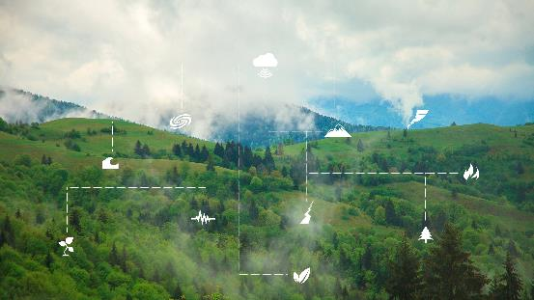

Azure Arc
Azure Arc
Develop cloud native, operate anywhere
Harness data insights from cloud to edge
Secure and govern across environments
Flexibly meet regulatory and connectivity needs

Slide 29
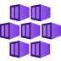
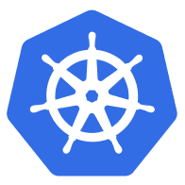


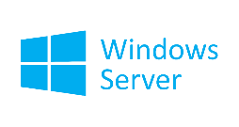
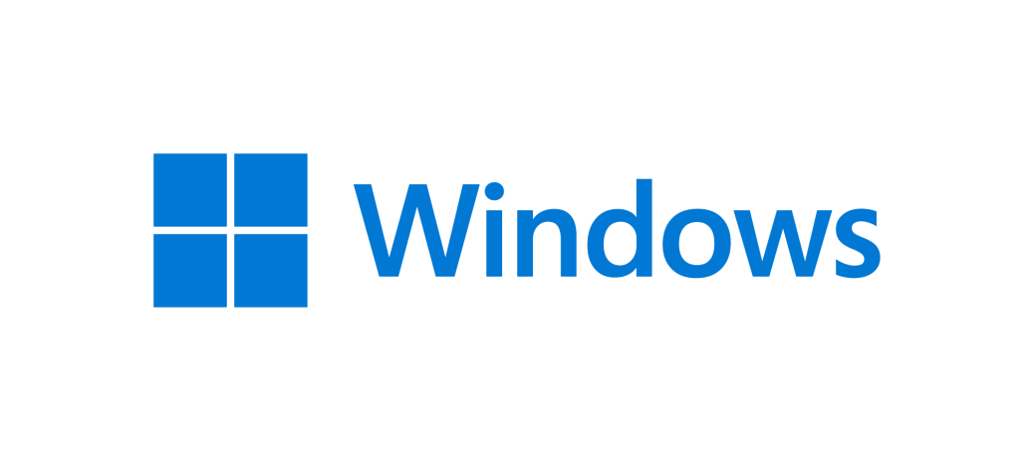

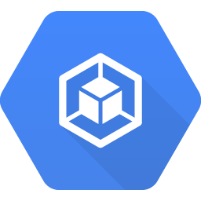
Managed Kubernetes from cloud to edge
AKS
3P Kubernetes
Kubernetes
OpenShift
EKS
VMware Tanzu
GKE
Azure
Windows Server & Azure Stack HCI
Edge Essentials
Any CNCF K8s
Azure Arc

Slide 30
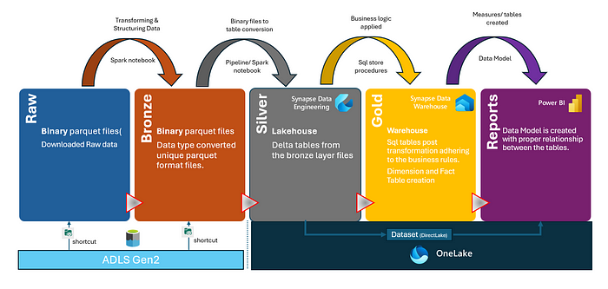
Facts: Medallion Architecture

Slide 31
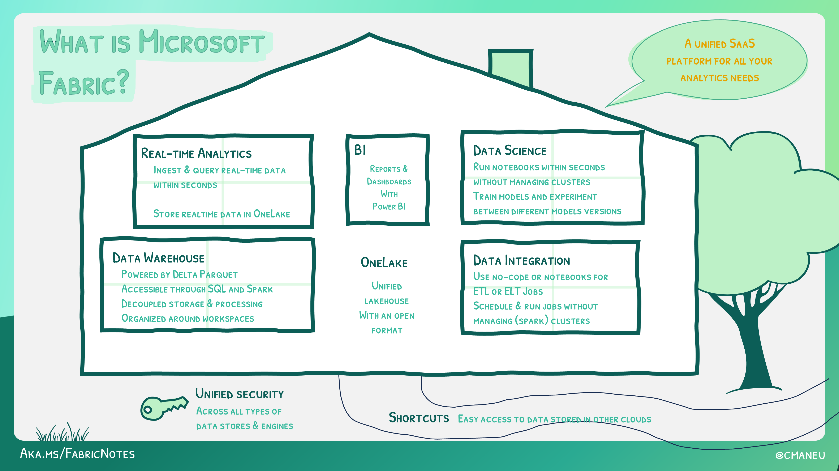
Il principale strumento IoT nel 2024 è Microsoft Fabric

Slide 32
Azure Networking

Slide 33
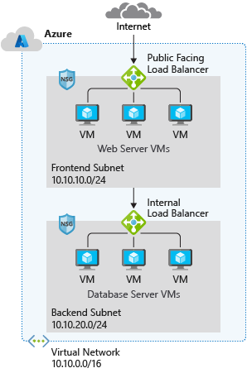
Capabilities of Azure Virtual Networks
Communication with the Internet
Communication between Azure resources
Communication between on-premises resources
Filtering network traffic
Routing network traffic
Notes:
Capabilities of Azure Virtual Networks
Azure VNet enables resources in Azure resources to securely communicate with each other, the internet, and on-premises networks.
Communication with the internet. All resources in a VNet can communicate outbound to the internet, by default. You can communicate inbound to a resource by assigning a public IP address or a public Load Balancer. You can also use public IP or public Load Balancer to manage your outbound connections.
Communication between Azure resources. There are three key mechanisms through which Azure resource can communicate: VNets, VNet service endpoints and VNet peering. Virtual Networks can connect not only VMs, but other Azure Resources, such as the App Service Environment, Azure Kubernetes Service, and Azure VM Scale sets. You can use service endpoints to connect to other Azure resource types, such as Azure SQL databases and storage accounts. When you create a VNet, your services and VMs within your VNet can communication directly and securely with each other in the cloud.
Communication between on-premises resources. Securely extend your data center. You can connect your on-premises computers and networks to a virtual network using any of the following options: Point-to-site virtual private network (VPN), Site-to-site VPN, Azure ExpressRoute.
Filtering network traffic. You can filter network traffic between subnets using any combination of network security groups and network virtual appliances like firewalls, gateways, proxies, and Network Address Translation (NAT) services.
Routing network traffic. Azure routes traffic between subnets, connected virtual networks, on-premises networks, and the Internet, by default. You can implement route tables or border gateway protocol (BGP) routes to override the default routes Azure creates.

Slide 34
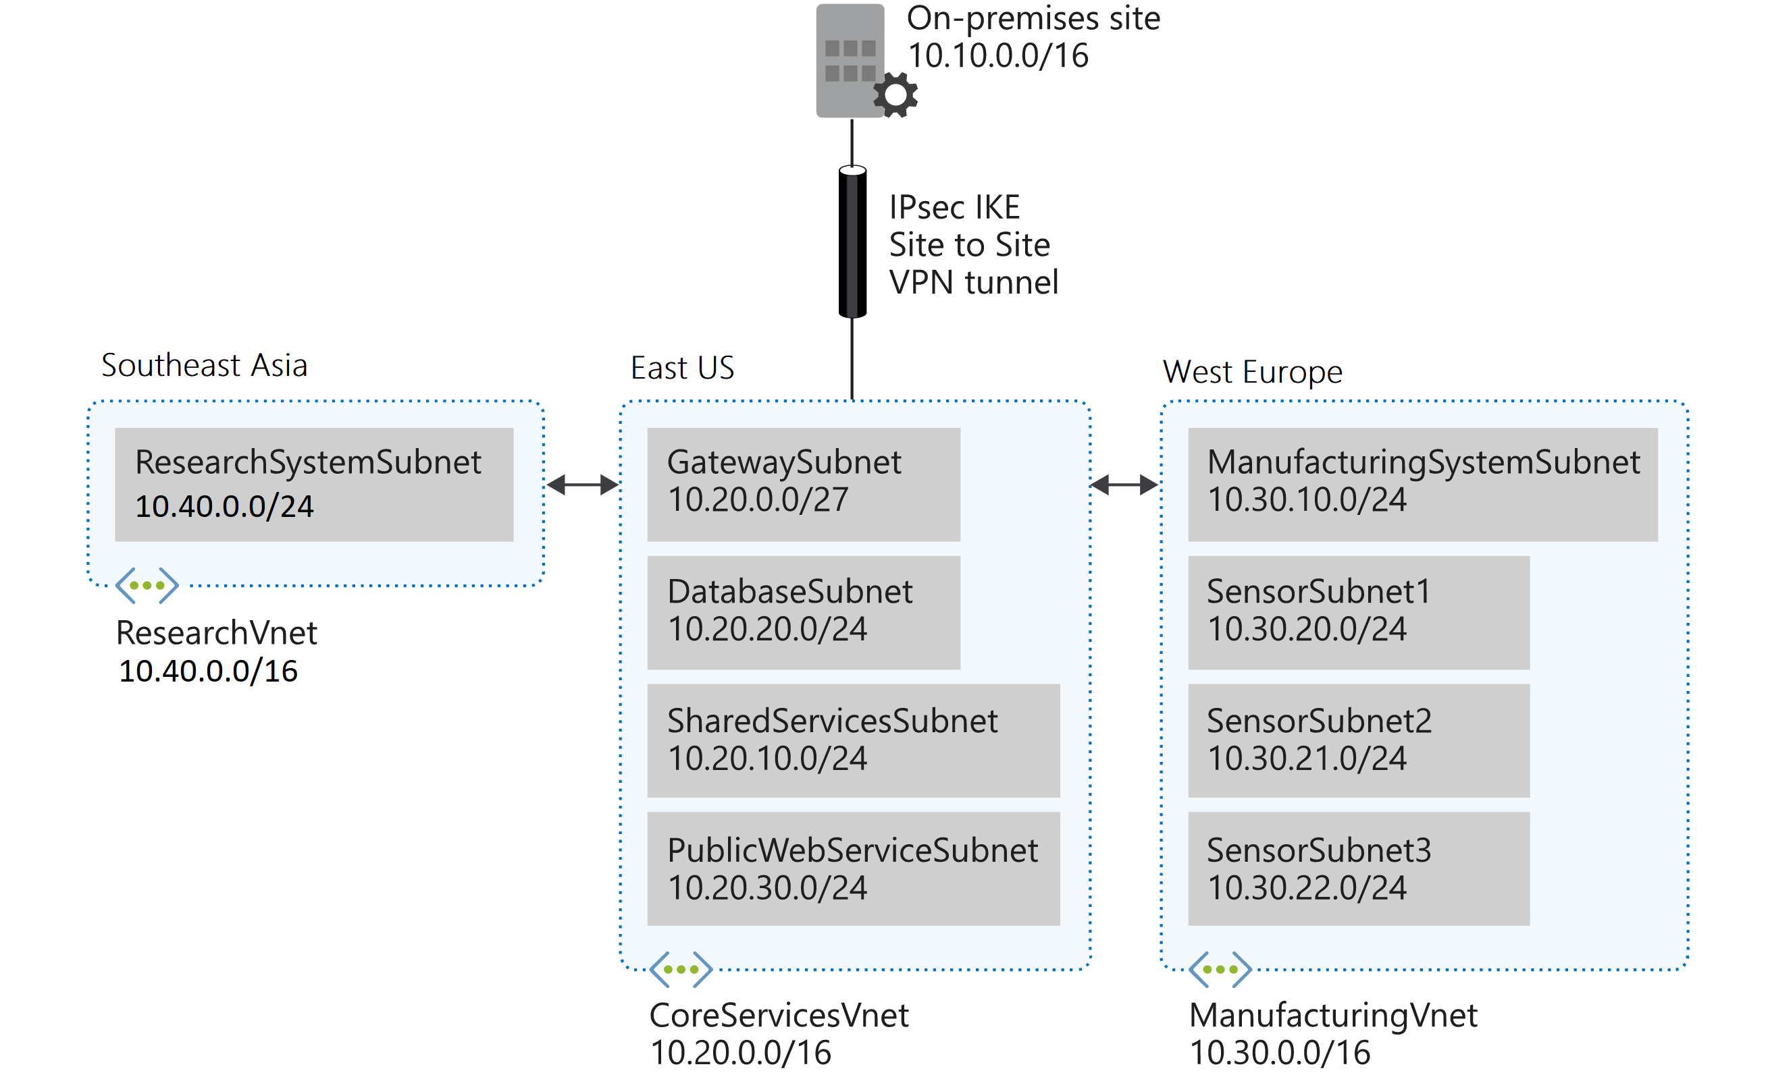
Design and implement a Virtual Network in Azure
Task 1: Create the Contoso resource group
Task 2: Create the CoreServicesVnet virtual network and subnets
Task 3: Create the ManufacturingVnet virtual network and subnets
Task 4: Create the ResearchVnet virtual network and subnets
Task 5: Verify the creation of VNets and Subnets
Notes:
Design and implement IP addressing for Azure virtual networks
in this exercise you will deploy an azure virtual network and configure the subnets
AZ-700-Designing-and-Implementing-Microsoft-Azure-Networking-Solutions/4-exercise-design-implement-virtual-network-azure.md at master · MicrosoftLearning/AZ-700-Designing-and-Implementing-Microsoft-Azure-Networking-Solutions (github.com)
https://microsoftlearning.github.io/AZ-700-Designing-and-Implementing-Microsoft-Azure-Networking-Solutions/Instructions/Exercises/M01-Unit%204%20Design%20and%20implement%20a%20Virtual%20Network%20in%20Azure.html

Slide 35
Azure Security benchmark
The Azure Security Benchmark (ASB) provides prescriptive best practices and recommendations to help improve the security of workloads, data, and services on Azure
Term | Description | Example
Control | A control is a high-level description of a feature or activity that needs to be addressed and is not specific to a technology or implementation. | Data Protection is one of the security controls. This control contains specific actions that must be addressed to help ensure data is protected.
Benchmark | A benchmark contains security recommendations for a specific technology, such as Azure. The recommendations are categorized by the control to which they belong. | The Azure Security Benchmark comprises the security recommendations specific to the Azure platform.
Baseline | A baseline is the implementation of the benchmark on the individual Azure service. Each organization decides benchmark recommendation and corresponding configurations are needed in the Azure implementation scope. | The Contoso company looks to enabling Azure SQL security features by following the configuration recommended in Azure SQL security baseline.
Security controls: These recommendations are generally applicable across your Azure tenant and Azure services. Each recommendation identifies a list of stakeholders that are typically involved in planning, approval, or implementation of the benchmark.
Service baselines: These apply the controls to individual Azure services to provide recommendations on that service’s security configuration.
Notes:
The Azure Security Benchmark includes a collection of high-impact security recommendations you can use to help secure the services you use in Azure:
Security controls: These recommendations are generally applicable across your Azure tenant and Azure services. Each recommendation identifies a list of stakeholders that are typically involved in planning, approval, or implementation of the benchmark.
Service baselines: These apply the controls to individual Azure services to provide recommendations on that service’s security configuration.
Implement the Azure Security Benchmark
Plan your Azure Security Benchmark implementation by reviewing the documentation for the enterprise controls and service-specific baselines to plan your control framework and how it maps to guidance like CIS (Controls v7.1) and NIST (SP 800-53) framework.
Monitor your compliance with Azure Security Benchmark status (and other control sets) using the Microsoft Defender for Cloud regulatory compliance dashboard.
Establish guardrails to automate secure configurations and enforce compliance with Azure Security Benchmark (and other requirements in your organization) with Azure Blueprints and Azure Policy.

Slide 36
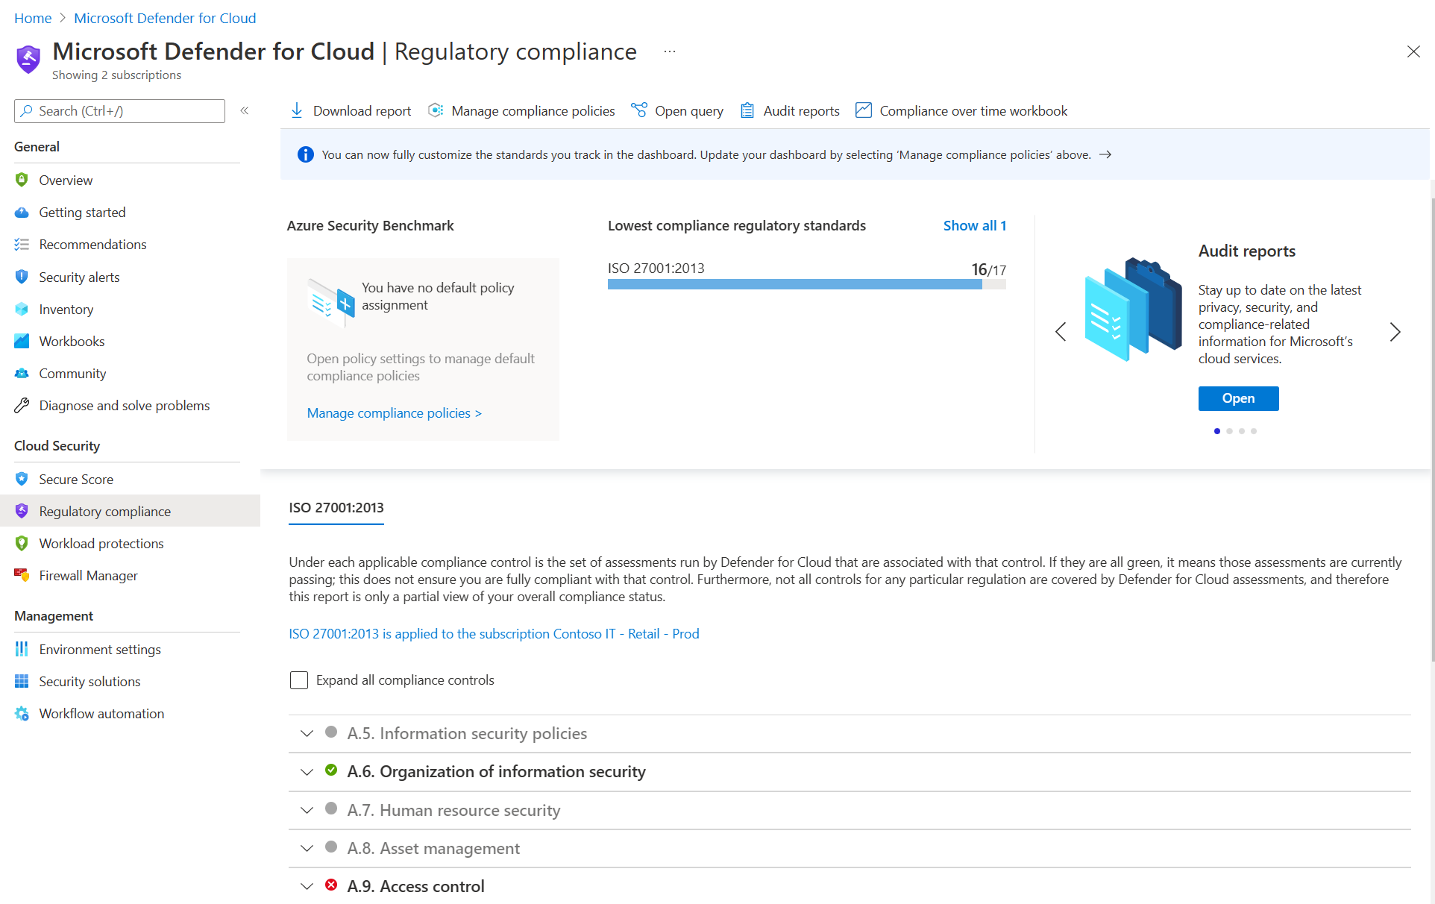
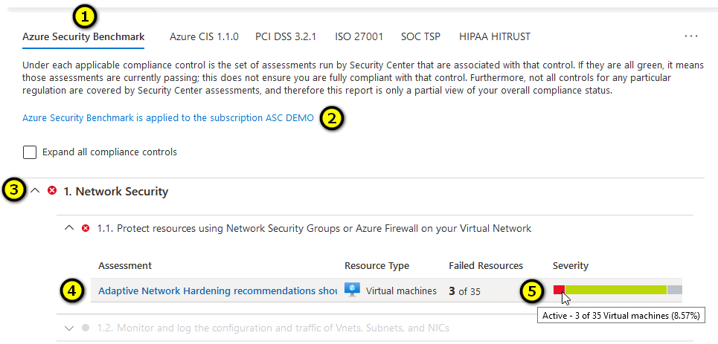
Using Microsoft Defender for Cloud for regulatory compliance
Microsoft Defender for Cloud helps streamline the process for meeting regulatory compliance requirements, using the regulatory compliance dashboard.

Slide 37
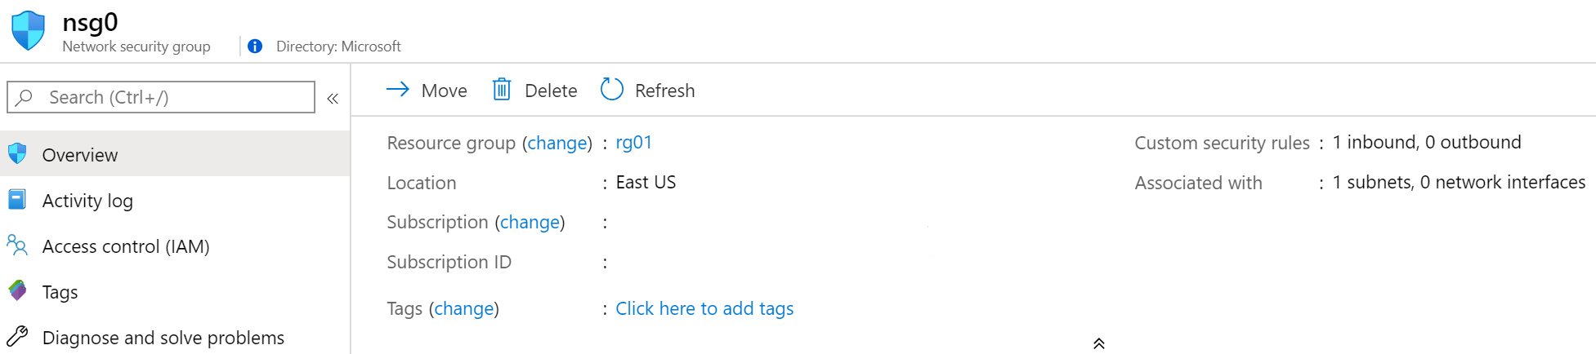
Network Security Groups
Limits network traffic to resources in a virtual network
Lists the security rules that allow or deny inbound or outbound network traffic
Associated to a subnet or a network interface
Can be associated multiple times
Notes:
Network Security Groups - https://docs.microsoft.com/en-us/azure/virtual-network/security-overview#network-security-groups
✔️ To simplify management of security rules, it's recommended that you associate a network security group to individual subnets, rather than individual network interfaces within the subnet.

Slide 38
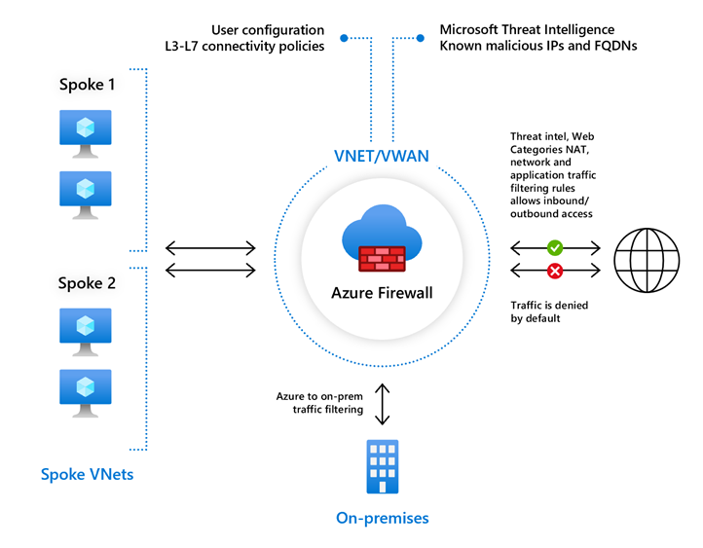
Azure Firewall features
Stateful firewall as a service
Built-in high availability with unrestricted cloud scalability
Create, enforce, and log application and network connectivity policies
Threat intelligence-based filtering for L3-L7
Fully integrated with Azure Monitor for logging and analytics
Support for hybrid connectivity through deployment behind VPN and ExpressRoute Gateways
Standard and Premium SKUs
Notes:
Azure Firewall documentation - https://docs.microsoft.com/en-us/azure/firewall/
Standard and Premium SKUs
Compare NSG and Firewall

Slide 39
Core Azure architectural components

Slide 40
Objective Domain
Regions and Region Pairs
Availability Zones
Azure Resources
Resource Groups
Azure Resource Manager
Subscriptions
Azure Management Groups
Notes:
Learn and SkillPipe content order note:
Slides 3-5
https://docs.microsoft.com/en-us/learn/modules/azure-architecture-fundamentals/introduction
https://docs.microsoft.com/en-us/learn/modules/azure-architecture-fundamentals/overview

Slide 41
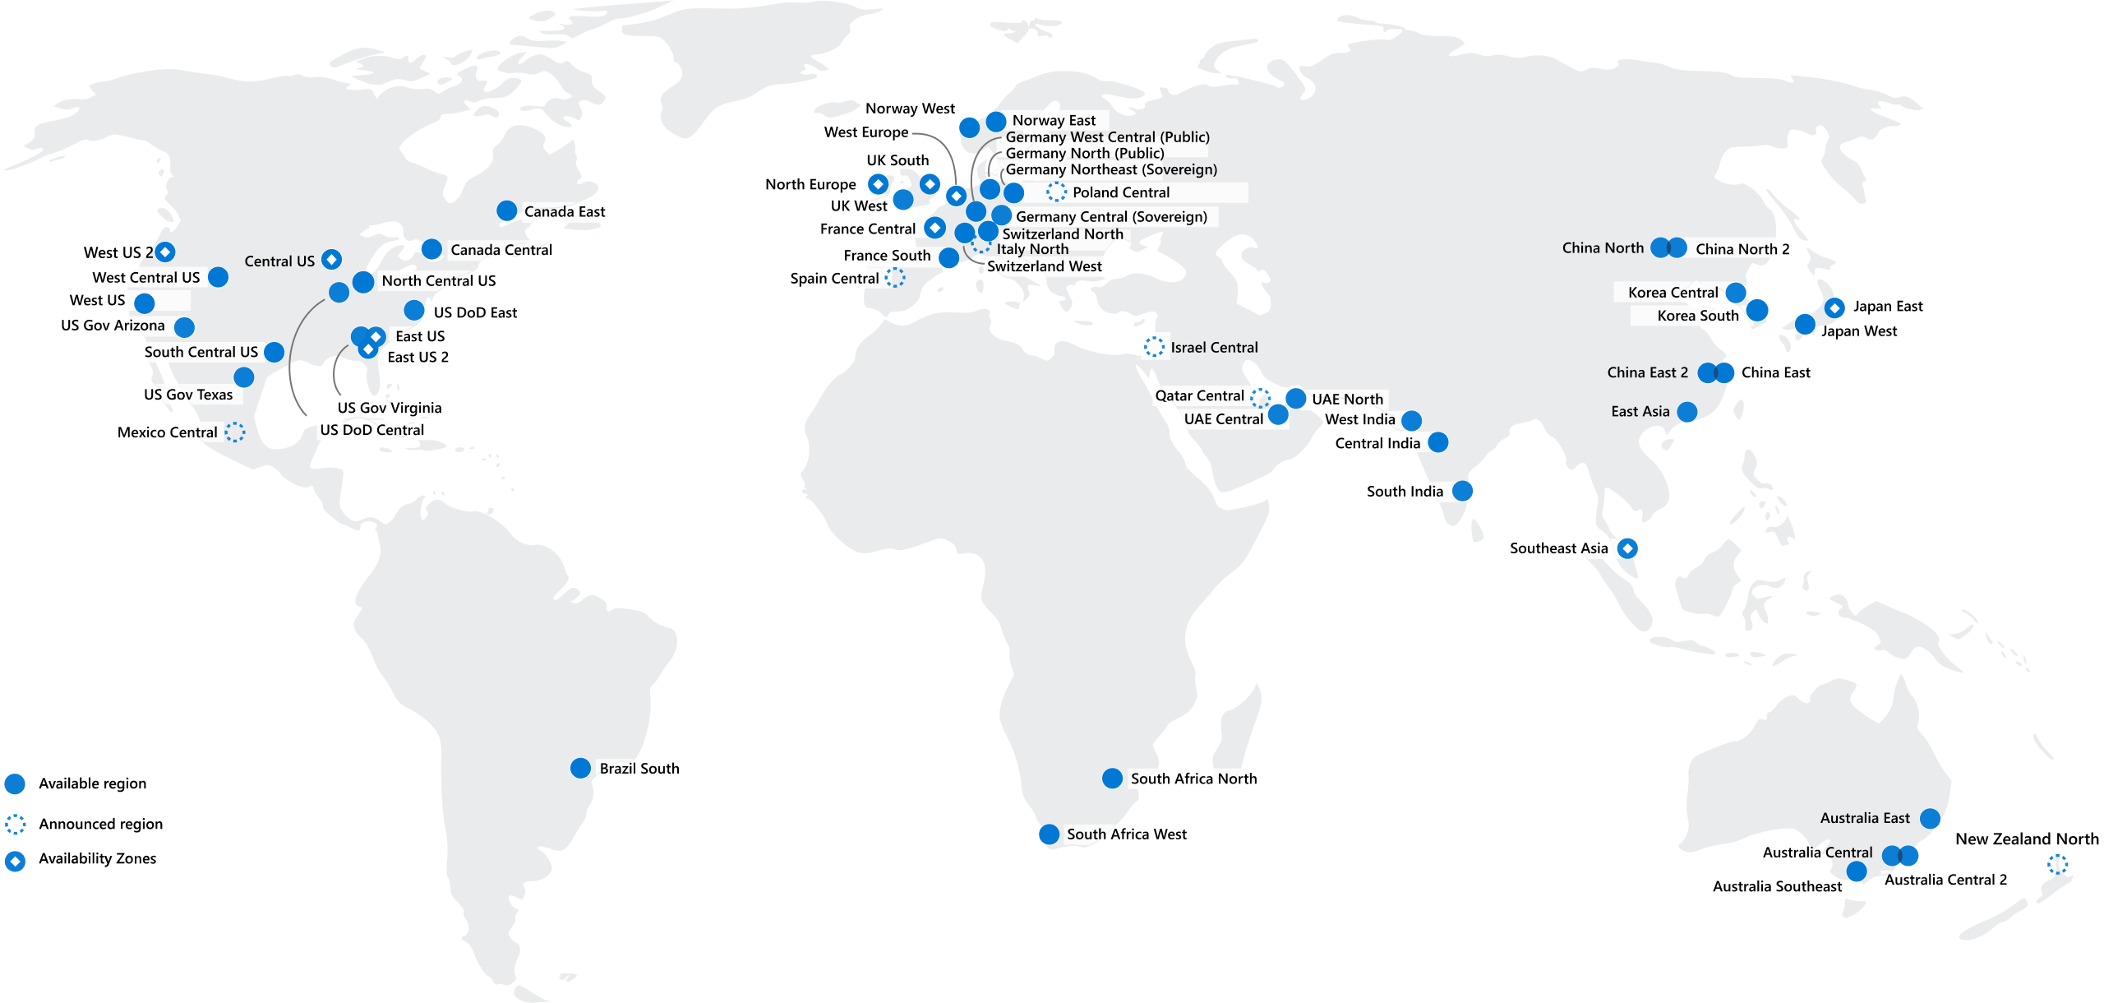
Regions
Azure offers more global regions than any other cloud provider with 60+ regions representing over 140 countries
Regions are made up of one or more datacenters in close proximity.
Provide flexibility and scale to reduce customer latency.
Preserve data residency with a comprehensive compliance offering.
© Copyright Microsoft Corporation. All rights reserved.
Notes:
A region represents a collection of datacenters.
Provide flexibility and scale.
Preserve data residency.
Select regions close to your users.
Be aware of region deployment availability.
There are global services that are region independent.
A list of regions and their locations is available at https://azure.microsoft.com/en-us/global-infrastructure/locations/
Learn and SkillPipe content order note:
Slides 6-10
https://docs.microsoft.com/en-us/learn/modules/azure-architecture-fundamentals/regions-availability-zones

Slide 42
Region Pairs
Region
North Central US​
East US​
West US 2​
US East 2​
Canada Central​
North Europe​
UK West​
Germany Central​
South East Asia​
East China​
Japan East​
Australia Southeast​
India South​
Brazil South (Primary)​
Region
South Central US​
West US​
West Central US​
Central US​
Canada East​
West Europe​
UK South​
Germany Northeast​
East Asia​
North China​
Japan West​
Australia East​
India Central​
South Central US ​
At least 300 miles of separation between region pairs.
Automatic replication for some services.
Prioritized region recovery in the event of outage.
Updates are rollout sequentially to minimize downtime.
Web Link: https://aka.ms/PairedRegions
© Copyright Microsoft Corporation. All rights reserved.
Notes:
Each Azure region is paired with another region.
Azure prefers at least 300 miles of separation between datacenters in a regional pair.
Some services provide automatic replication to the paired region.
In an outage, recovery of one region is prioritized out of every pair.
Azure system updates are rolled out to paired regions sequentially (not at the same time).
List of geographies, regions, region-pairs, and other details -https://azure.microsoft.com/en-us/global-infrastructure/geographies/
A full list of region pairs is available at https://docs.microsoft.com/en-us/azure/best-practices-availability-paired-regions#what-are-paired-regions
Learn and SkillPipe content order note:
Slides 6-10
https://docs.microsoft.com/en-us/learn/modules/azure-architecture-fundamentals/regions-availability-zones

Slide 43
Availability Options
VM SLA
99.9% with Premium Storage
VM SLA
99.99%
MULTI-REGION DISASTER RECOVERY
Region 1
Region 2
SINGLE VM
Easier lift and shift
AVAILABILITY ZONES
Protection from entire datacenter failures
REGION PAIRS
Regional protection within Data Residency Boundaries
Notes:
This slide is to introduce the upcoming topics. You could also use the slide at the end of the lesson to
Learn and SkillPipe content order note:
Slides 6-10
https://docs.microsoft.com/en-us/learn/modules/azure-architecture-fundamentals/regions-availability-zones
review.

Slide 44
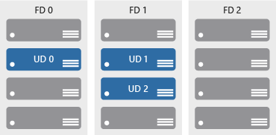

Availability zones
Azure Region
Provide protection against downtime due to datacenter failure.
Physically separate datacenters within the same region.
Each datacenter is equipped with independent power, cooling, and networking.
Connected through private fiber-optic networks.
Availability Zone 1
Availability Zone 2
Availability Zone 3
© Copyright Microsoft Corporation. All rights reserved.
Notes:
Physically separate locations within an Azure region.
Takes availability sets to the next level
Includes one or more datacenters, equipped with independent power, cooling, and networking.
Acts as an isolation boundary.
If one availability zone goes down, the other continues working.
More details about Availability Zones in Azure are available at https://docs.microsoft.com/en-us/azure/availability-zones/az-overview
Learn and SkillPipe content order note:
Slides 6-10
https://docs.microsoft.com/en-us/learn/modules/azure-architecture-fundamentals/regions-availability-zones

Slide 45






Azure Resources
Azure resources are components like storage, virtual machines, and networks that are available to build cloud solutions.
Virtual Machines
Storage Accounts
Virtual Networks
App Services
SQL Databases
Functions
Notes:
Learn and SkillPipe content order note:
Slides 11-13
https://docs.microsoft.com/en-us/learn/modules/azure-architecture-fundamentals/resources-resource-manager

Slide 46



Resource groups
Resource groups (web + DB, VM, Storage) in one group
A resource group is a container to manage and aggregate resources in a single unit.
Resources can exist in only one resource group.
Resources can exist in different regions.
Resources can be moved to different resource groups.
Applications can utilize multiple resource groups.
OR
Web and DB resource group
Virtual machine resource group
Storage resource group
© Copyright Microsoft Corporation. All rights reserved.
Notes:
Containers for multiple resources that share the same life cycle.
Aggregates resources into a single manageable unit.
Every Azure resource must exist in one (and only one) resource group.
Secure at the resource group (or resource) level - using role-based access control (RBAC).
Learn and SkillPipe content order note:
Slides 11-13
https://docs.microsoft.com/en-us/learn/modules/azure-architecture-fundamentals/resources-resource-manager

Slide 47
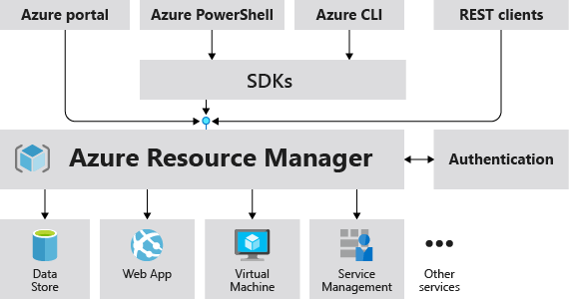
Azure Resource Manager
The Azure Resource Manager (ARM) provides a management layer that enables you to create, update, and delete resources in your Azure subscription.
© Copyright Microsoft Corporation. All rights reserved.
Notes:
Provides a management layer that enables you to create, update, and delete resources in your Azure subscription.
Create, configure, manage and delete resources and resource groups.
Organizes resources.
Controls access and resources.
Automates using different tools and SDKs.
Stores layouts in JSON files.
You can view more details about Azure Resource Manager at https://docs.microsoft.com/en-us/azure/azure-resource-manager
Learn and SkillPipe content order note:
Slides 11-13
https://docs.microsoft.com/en-us/learn/modules/azure-architecture-fundamentals/resources-resource-manager

Slide 48
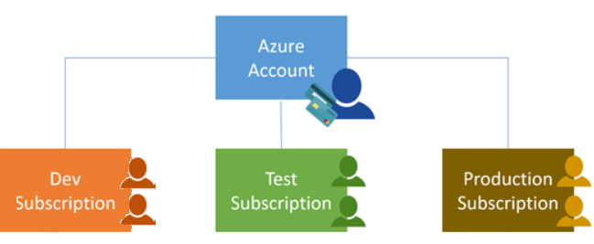
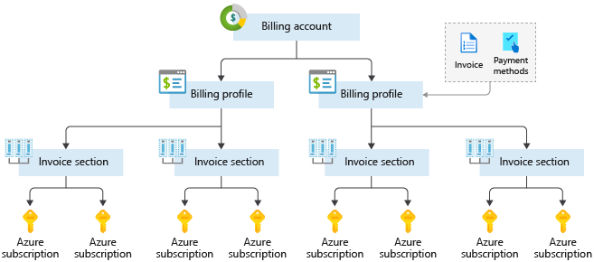
Azure Subscriptions
An Azure subscription provides you with authenticated and authorized access to Azure accounts.
Billing boundary: generate separate billing reports and invoices for each subscription.
Access control boundary: manage and control access to the resources that users can provision with specific subscriptions.
Notes:
An account can have one subscription or multiple subscriptions.
Azure subscription offers - https://azure.microsoft.com/en-us/support/legal/offer-details/
Learn and SkillPipe content order note:
Slides 14 & 16
https://docs.microsoft.com/en-us/learn/modules/azure-architecture-fundamentals/management-groups-subscriptions

Slide 49
Azure Services
Notes:
Learn and SkillPipe content order note:
Slides 3-5
https://docs.microsoft.com/en-us/learn/modules/azure-architecture-fundamentals/introduction
https://docs.microsoft.com/en-us/learn/modules/azure-architecture-fundamentals/overview

Slide 50
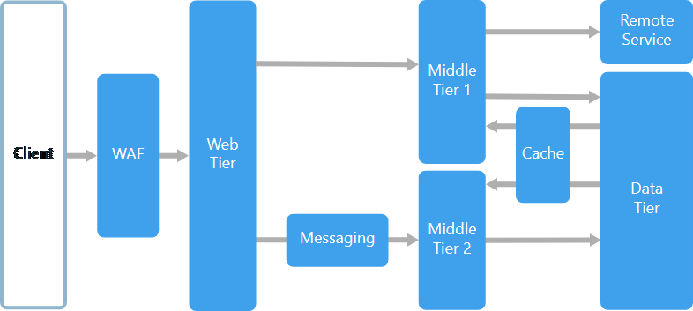
N-Tier

Slide 51
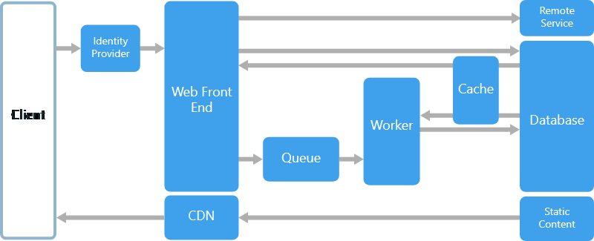
Web-Queue-Worker

Slide 52
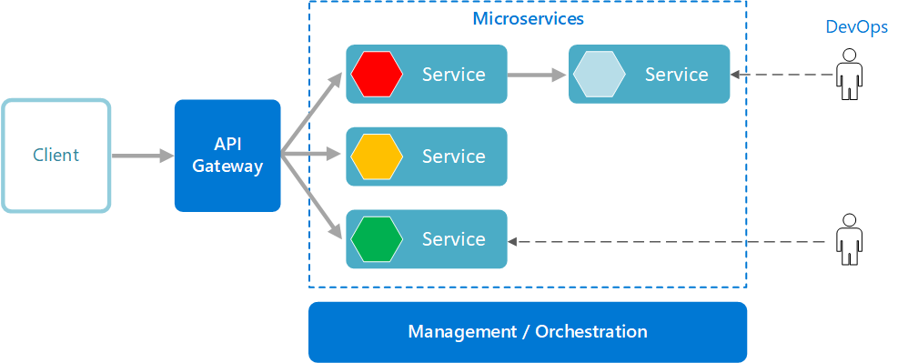
Microservices

Slide 53
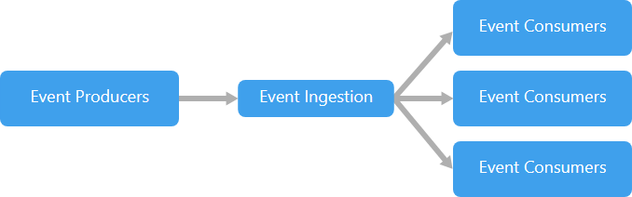
Event-driven architecture

Slide 54
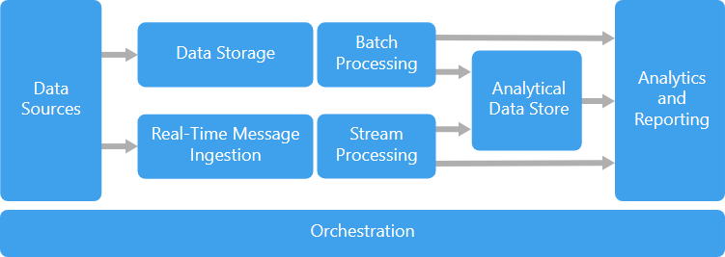
Big Data, Big Compute

Slide 55
Data redundancy and availability
Locally redundant storage
Zone-redundant storage
Geo-redundant storage (GRS)
Read-access GRS (RA-GRS)
Geo-zone-redundant storage (GZRS)

Slide 56
Asynchronous messaging options

Slide 57

Commands

Slide 58
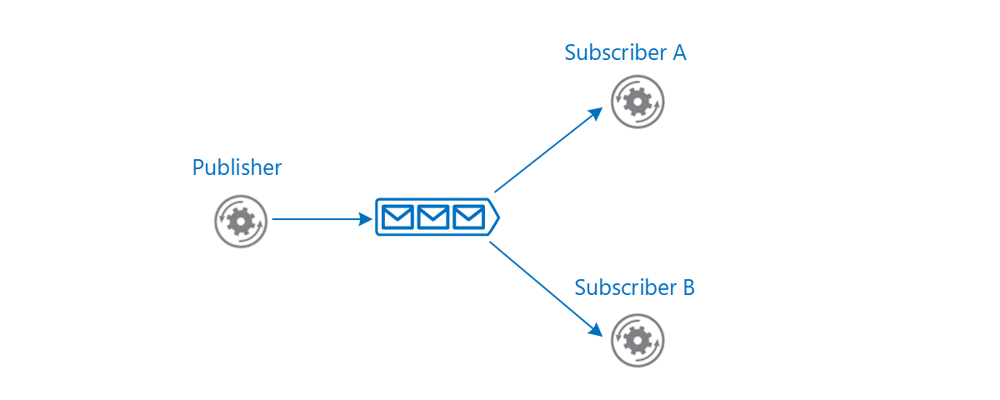
Events

Slide 59
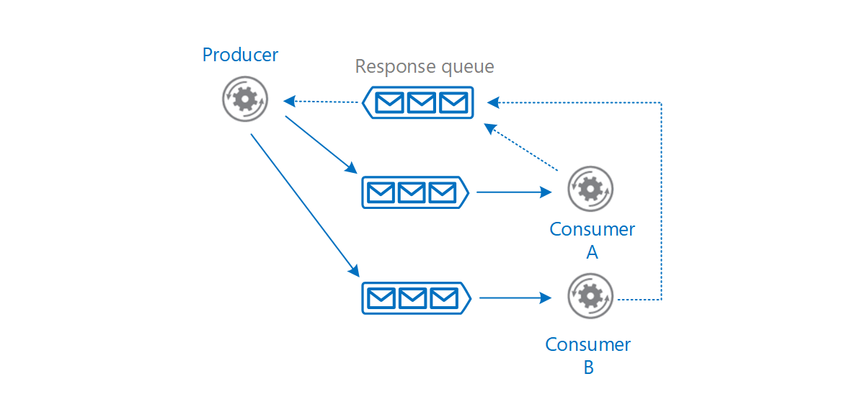
Decoupling

Slide 60
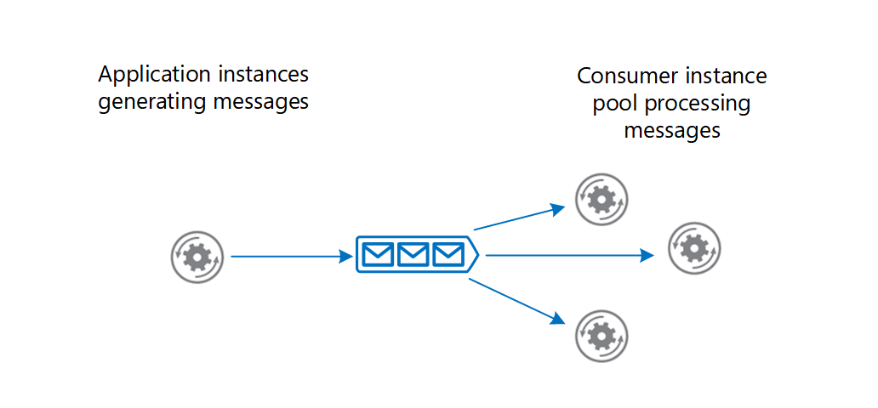
Load Balancing

Slide 61
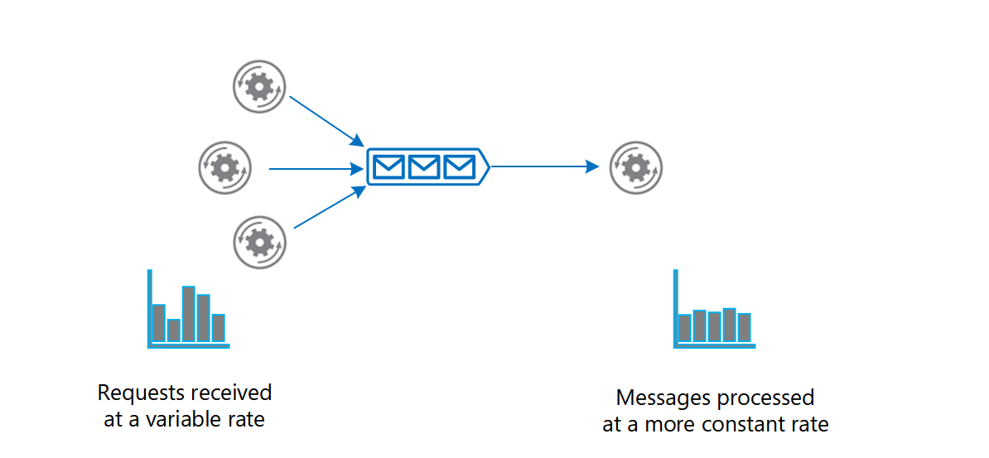
Load Levelling

